Slide 1
Learning Objective
I will be able to apply knowledge of expected value, variance and standard deviation to solve associated probability problems
Success Criteria
At the end of the lesson, I will be able to:
3.3.5 identify the mean or expected value of a discrete random variable as a measurement of centre, and evaluate it in simple cases
3.3.6 identify the variance and standard deviation of a discrete random variable as measures of spread, and evaluate them using technology
3.3.7 examine the effects of linear changes of scale and origin on the mean and the standard deviation
3.3.8 use discrete random variables and associated probabilities to solve practical problems

Slide 2
Understanding Expected Values
Suppose that you ask your grandmother for some money. Instead of just giving you the money, she offers to flip a coin.
If the coin lands “heads” – you win – and she will give you $20.
If it lands “tails”, you lose, and you receive nothing or $0.
In this example, we would say that the payout associated with the event that the coin lands “heads” is $20, and the payout associated with “tails” is $0. We can determine if this is a good deal by finding the expected value from this situation.
The expected value is found by the following:
EXPECTED VALUE = P(Head) × Payout(Head) + P(Tail) × Payout(Tail)
The expected value for this scenario is:
0.5 × 20 + 0.5 × 0 = $10

Slide 3
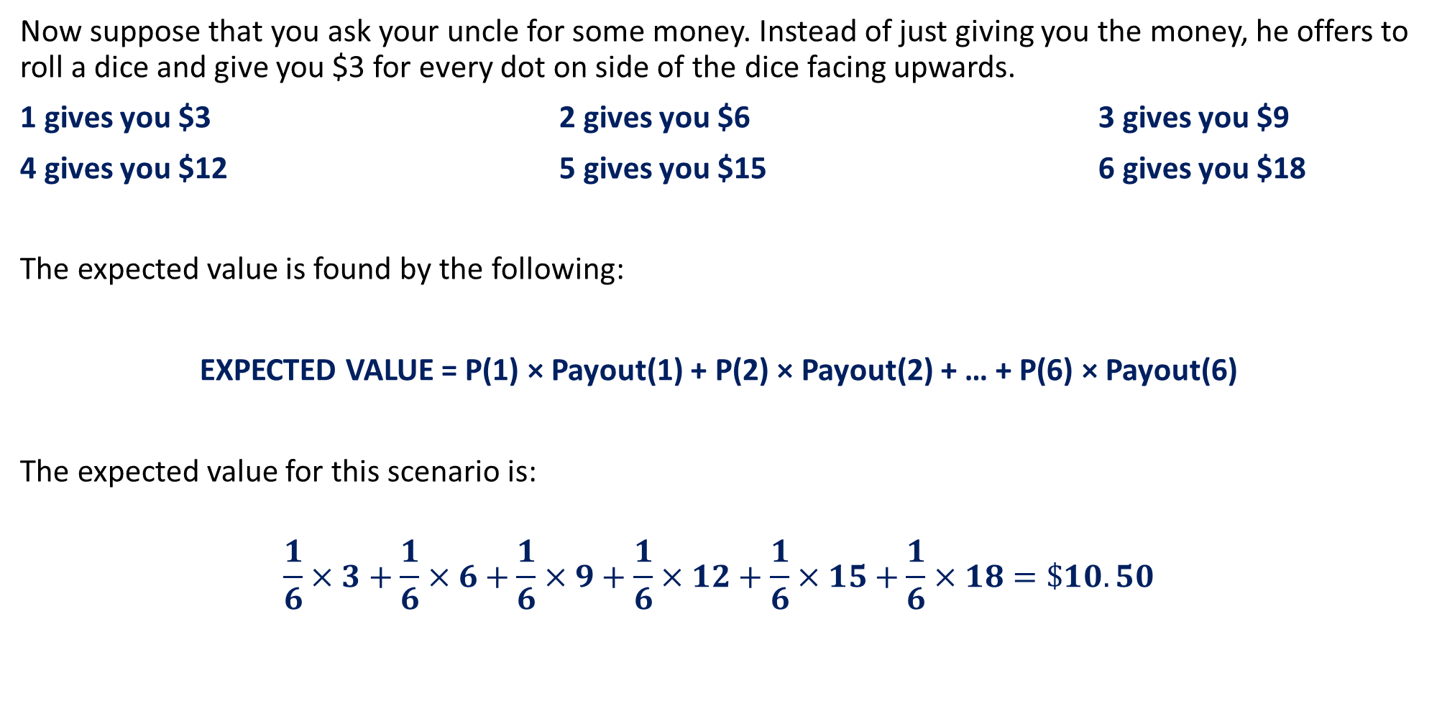
Understanding Expected Values
Now suppose that you ask your uncle for some money. Instead of just giving you the money, he offers to roll a dice and give you $3 for every dot on side of the dice facing upwards.
1 gives you $3 2 gives you $6 3 gives you $9
4 gives you $12 5 gives you $15 6 gives you $18
The expected value is found by the following:
EXPECTED VALUE = P(1) × Payout(1) + P(2) × Payout(2) + … + P(6) × Payout(6)
The expected value for this scenario is:
$$\frac{1}{6}×3+\frac{1}{6}×6+\frac{1}{6}×9+\frac{1}{6}×12+\frac{1}{6}×15+\frac{1}{6}×18=\$10.50$$

Slide 4
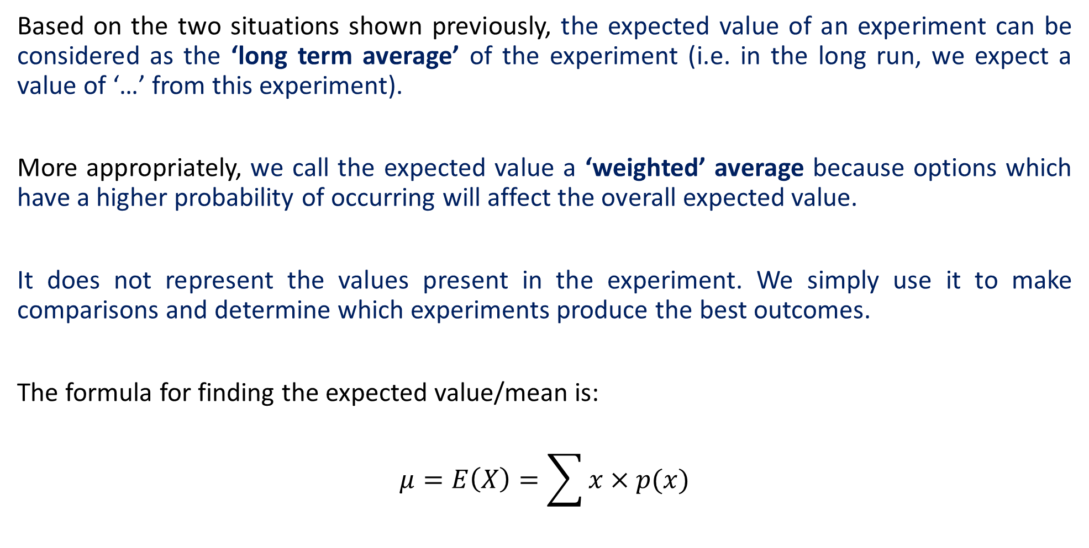
The Definition of Expected Value
Based on the two situations shown previously, the expected value of an experiment can be considered as the ‘long term average’ of the experiment (i.e. in the long run, we expect a value of ‘…’ from this experiment).
More appropriately, we call the expected value a ‘weighted’ average because options which have a higher probability of occurring will affect the overall expected value.
It does not represent the values present in the experiment. We simply use it to make comparisons and determine which experiments produce the best outcomes.
The formula for finding the expected value/mean is:
$$μ=E\left(X\right)=\sum{x×p(x)}$$

Slide 5
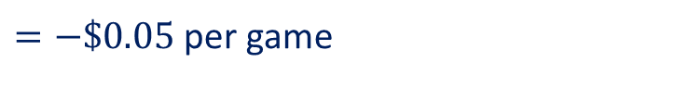
Guided Practice
A person may buy a lucky ticket for $1. They have a 20% chance of winning $2, a 5% chance of winning $11, and otherwise they lose. Is this a good game to play?
$$X−\text{be} \text{the} \text{amount} \text{the} \text{person} \text{will} \text{profit} \text{from} \text{each} \text{game}$$
$$X$$ | -1 | 1 | 10
$$P(X=x)$$ | $$0.75$$ | $$0.2$$ | $$0.05$$
$$E\left(X\right)=−1\left(0.75\right)+1\left(0.2\right)+10(0.05)$$
$=−\$0.05$ per game
No, it is not a good game to play

Slide 6
Guided Practice
A game involves a player paying money to roll two dice. If the total of the two numbers on the uppermost faces is:
Less than 6, then the player receives $5
More than 9, then the player receives $8,
Any other score, then the player receives nothing.
What is the amount the player could expect to
receive, on average, per game (i.e. what is the mean
or expected payout per game)?
b) If the cost for each roll of the two dice is $3, is a player likely to win, lose or break even in the long term?
 | 1 | 2 | 3 | 4 | 5 | 6
1 | 2 | 3 | 4 | 5 | 6 | 7
2 | 3 | 4 | 5 | 6 | 7 | 8
3 | 4 | 5 | 6 | 7 | 8 | 9
4 | 5 | 6 | 7 | 8 | 9 | 10
5 | 6 | 7 | 8 | 9 | 10 | 11
6 | 7 | 8 | 9 | 10 | 11 | 12

Slide 7



Guided Practice
Let X be the sum of the outcome of the die roll
 | 1 | 2 | 3 | 4 | 5 | 6
1 | 2 | 3 | 4 | 5 | 6 | 7
2 | 3 | 4 | 5 | 6 | 7 | 8
3 | 4 | 5 | 6 | 7 | 8 | 9
4 | 5 | 6 | 7 | 8 | 9 | 10
5 | 6 | 7 | 8 | 9 | 10 | 11
6 | 7 | 8 | 9 | 10 | 11 | 12
Less than 6, then the player receives $5
More than 9, then the player receives $8,
Any other score, then the player receives nothing
$$x$$ | 2 | 3 | 4 | 5 | 6 | 7 | 8 | 9 | 10 | 11 | 12
$$P(X=x)$$ | $$\frac{1}{36}$$ | $$\frac{2}{36}$$ | $$\frac{3}{36}$$ | $$\frac{4}{36}$$ | $$\frac{5}{36}$$ | $$\frac{6}{36}$$ | $$\frac{5}{36}$$ | $$\frac{4}{36}$$ | $$\frac{3}{36}$$ | $$\frac{2}{36}$$ | $$\frac{1}{36}$$
Player receives $5
Player receives $0
Player receives $8
Total Probability = $\frac{10}{36}$
Total Probability = $\frac{20}{36}$
Total Probability = $\frac{6}{36}$

Slide 8
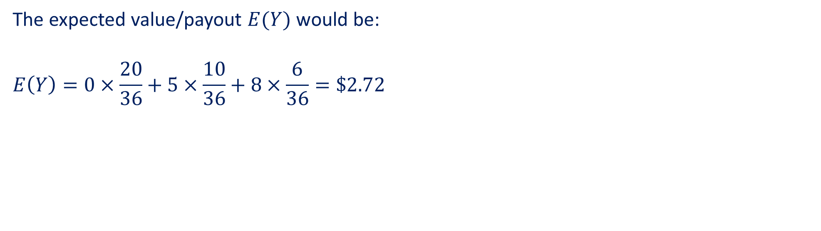
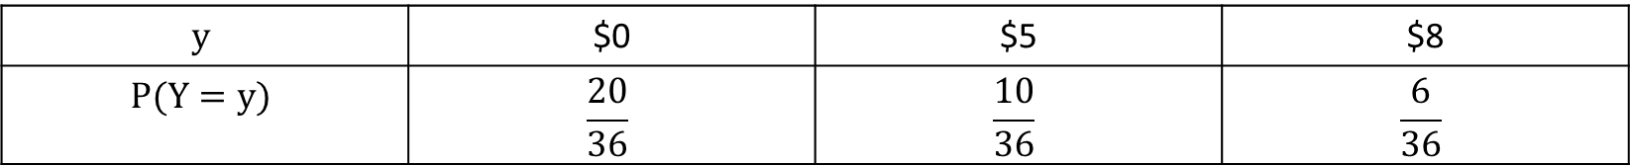
Guided Practice
Let the discrete random variable Y be the amount the player receives such that the PDF appears as shown below.
$$y$$ | $0 | $5 | $8
$$P(Y=y)$$ | $$\frac{20}{36}$$ | $$\frac{10}{36}$$ | $$\frac{6}{36}$$
The expected value/payout $E(Y)$ would be:
$$E\left(Y\right)=0×\frac{20}{36}+5×\frac{10}{36}+8×\frac{6}{36}=\$2.72$$

Slide 9
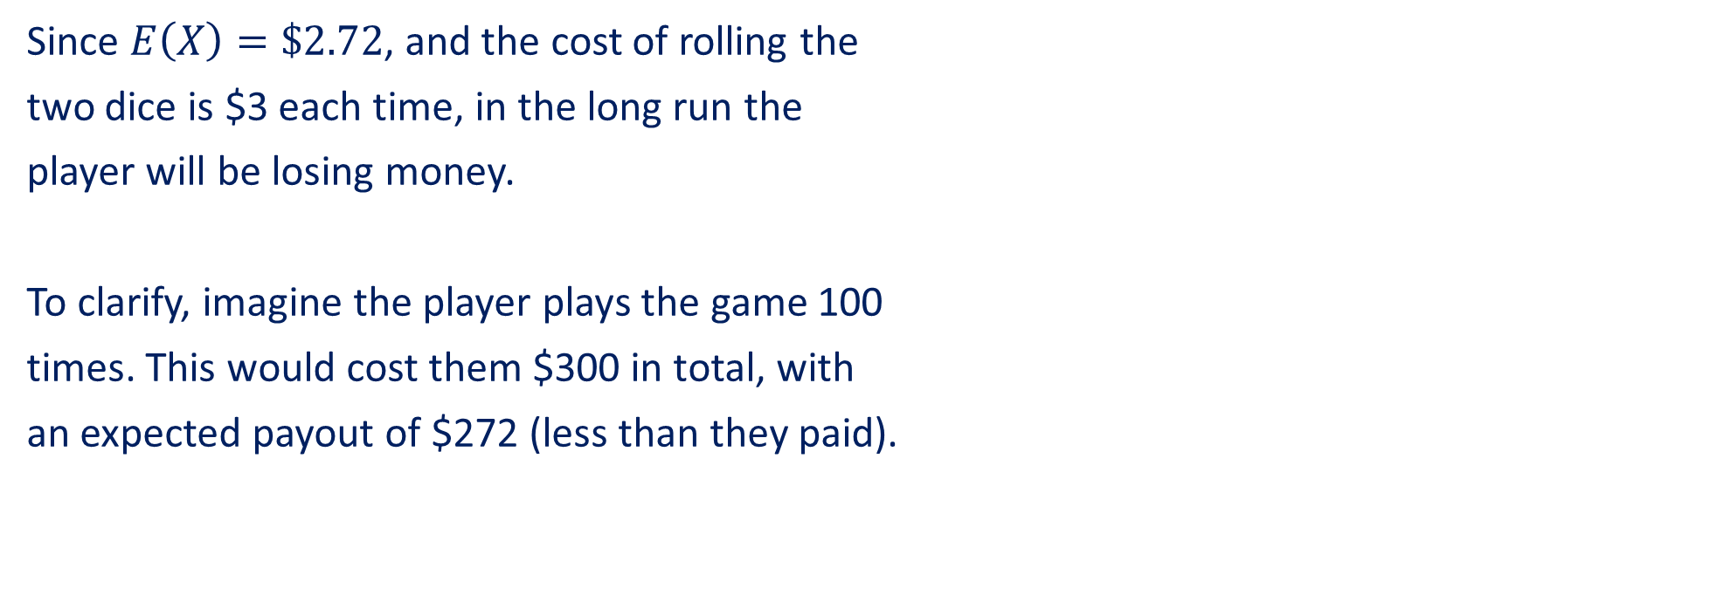
Guided Practice
b) If the cost for each roll of the two dice is $3, is a player likely to win, lose or break even in the long term?
 | 1 | 2 | 3 | 4 | 5 | 6
1 | 2 | 3 | 4 | 5 | 6 | 7
2 | 3 | 4 | 5 | 6 | 7 | 8
3 | 4 | 5 | 6 | 7 | 8 | 9
4 | 5 | 6 | 7 | 8 | 9 | 10
5 | 6 | 7 | 8 | 9 | 10 | 11
6 | 7 | 8 | 9 | 10 | 11 | 12
Since $E\left(X\right)=\$2.72$, and the cost of rolling the
two dice is $3 each time, in the long run the
player will be losing money.
To clarify, imagine the player plays the game 100
times. This would cost them $300 in total, with
an expected payout of $272 (less than they paid).

Slide 10
Understanding Standard Deviation

Slide 11
Understanding Standard Deviation
In the previous situation, though we had the same mean, mode and median for the two basketball
teams, we could see there was more variation in one dataset compared to the other.
There are two statistical measures we will look at that measures this variation: variance and
standard deviation.
Standard deviation is a quantity that measures how much the members of group differ from the mean
value of the group.
Variance is the square of the standard deviation.

Slide 12
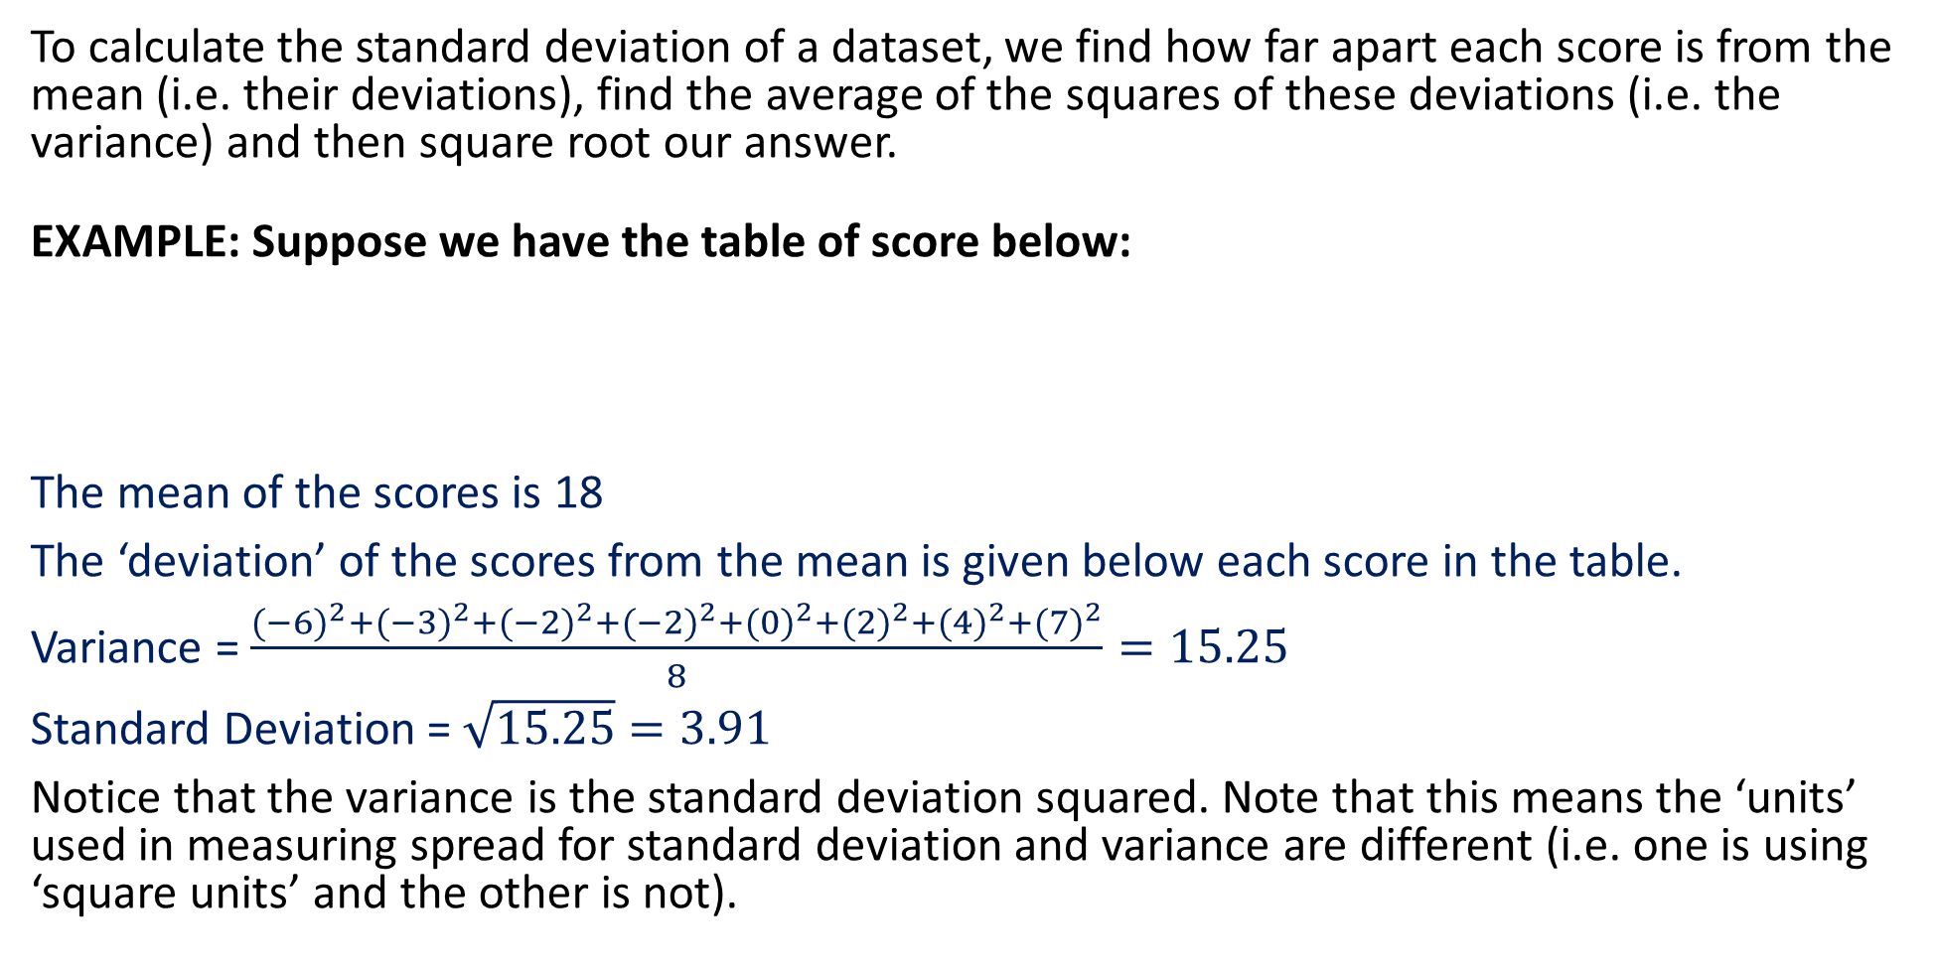
Calculating Standard Deviation
To calculate the standard deviation of a dataset, we find how far apart each score is from the mean (i.e. their deviations), find the average of the squares of these deviations (i.e. the variance) and then square root our answer.
EXAMPLE: Suppose we have the table of score below:
The mean of the scores is 18
The ‘deviation’ of the scores from the mean is given below each score in the table.
Variance = $\frac{{(−6)}^{2}+{(−3)}^{2}+{(−2)}^{2}+{(−2)}^{2}+{(0)}^{2}+{(2)}^{2}+{(4)}^{2}+{(7)}^{2}}{8}=15.25$
Standard Deviation = $\sqrt{15.25}=3.91$
Notice that the variance is the standard deviation squared. Note that this means the ‘units’ used in measuring spread for standard deviation and variance are different (i.e. one is using ‘square units’ and the other is not).
SCORES | 12 | 15 | 16 | 16 | 18 | 20 | 22 | 25
DEVIATION | -6 | -3 | -2 | -2 | 0 | 2 | 4 | 7

Slide 13
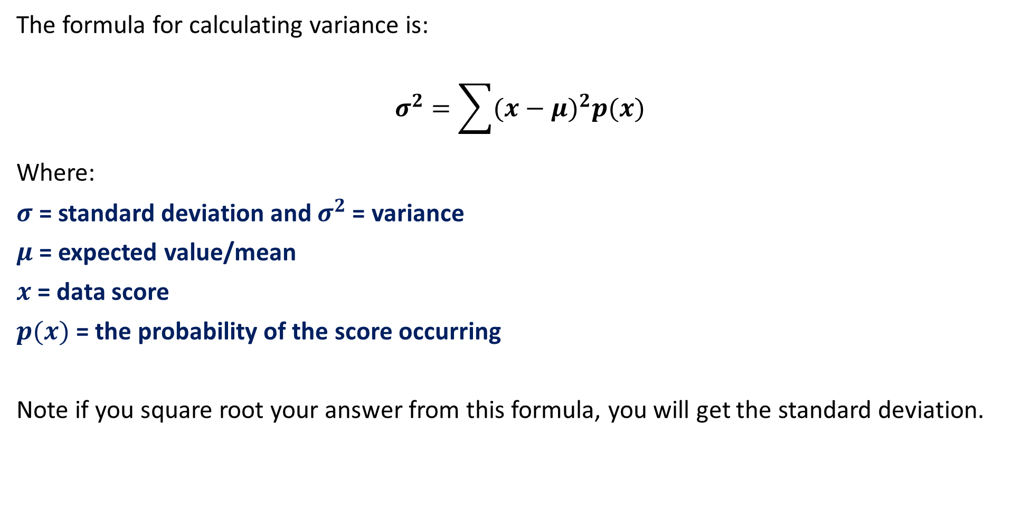
Calculating Standard Deviation
The formula for calculating variance is:
$$σ^{2}=\sum{(x−μ)^{2}p(x)}$$
Where:
$σ$ = standard deviation and $σ^{2}$ = variance
$μ$ = expected value/mean
$x$ = data score
$p(x)$ = the probability of the score occurring
Note if you square root your answer from this formula, you will get the standard deviation.

Slide 14
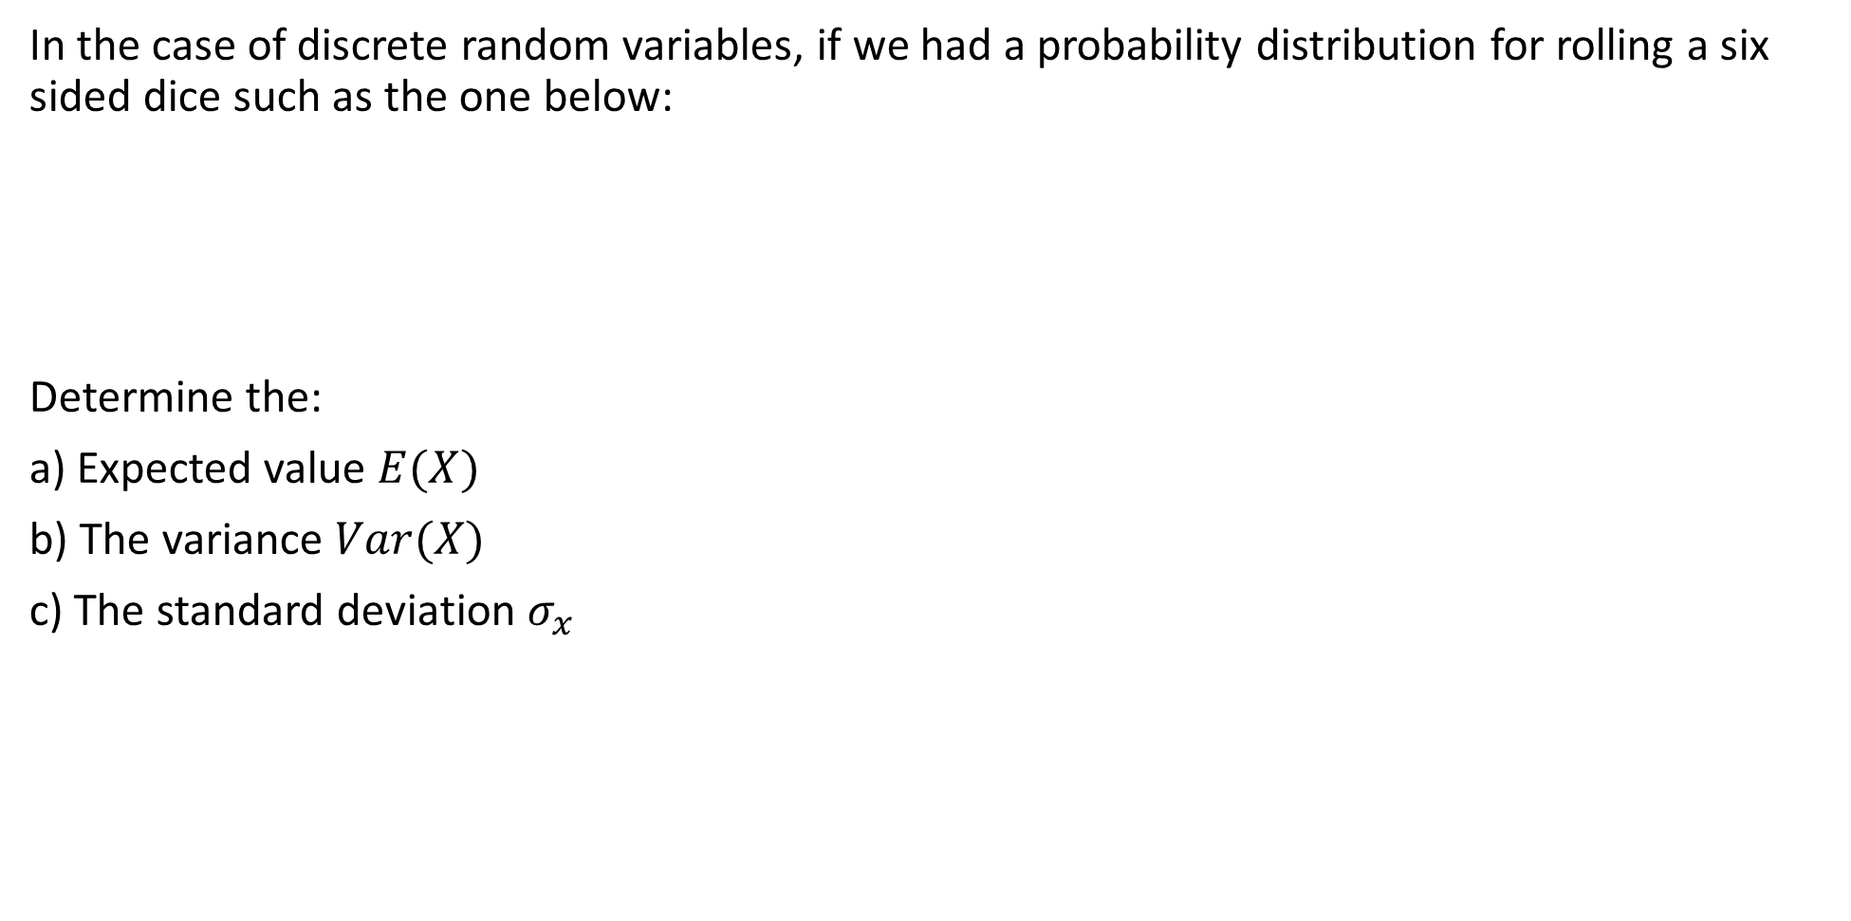
Guided Practice
In the case of discrete random variables, if we had a probability distribution for rolling a six sided dice such as the one below:
Determine the:
a) Expected value $E(X)$
b) The variance $Var(X)$
c) The standard deviation $σ_{x}$
x | 1 | 2 | 3 | 4 | 5 | 6
P(X = x) | $$\frac{1}{6}$$ | $$\frac{1}{6}$$ | $$\frac{1}{6}$$ | $$\frac{1}{6}$$ | $$\frac{1}{6}$$ | $$\frac{1}{6}$$

Slide 15
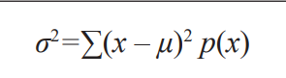
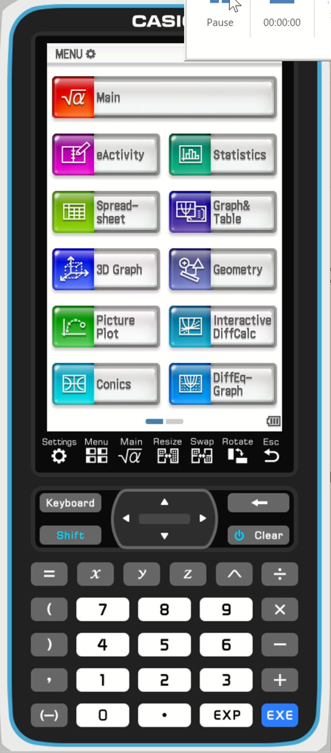
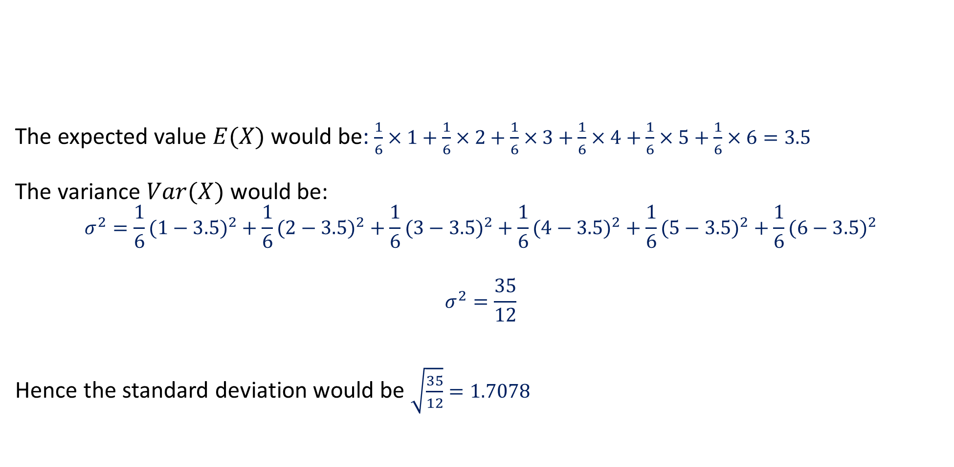
Guided Practice
The expected value $E(X)$ would be: $\frac{1}{6}×1+\frac{1}{6}×2+\frac{1}{6}×3+\frac{1}{6}×4+\frac{1}{6}×5+\frac{1}{6}×6=3.5$
The variance $Var(X)$ would be:
$$σ^{2}=\frac{1}{6}(1−3.5)^{2}+\frac{1}{6}(2−3.5)^{2}+\frac{1}{6}(3−3.5)^{2}+\frac{1}{6}(4−3.5)^{2}+\frac{1}{6}(5−3.5)^{2}+\frac{1}{6}(6−3.5)^{2}$$
$$σ^{2}=\frac{35}{12}$$
Hence the standard deviation would be $\sqrt{\frac{35}{12}}=1.7078$
x | 1 | 2 | 3 | 4 | 5 | 6
P(X = x) | $$\frac{1}{6}$$ | $$\frac{1}{6}$$ | $$\frac{1}{6}$$ | $$\frac{1}{6}$$ | $$\frac{1}{6}$$ | $$\frac{1}{6}$$

Slide 16


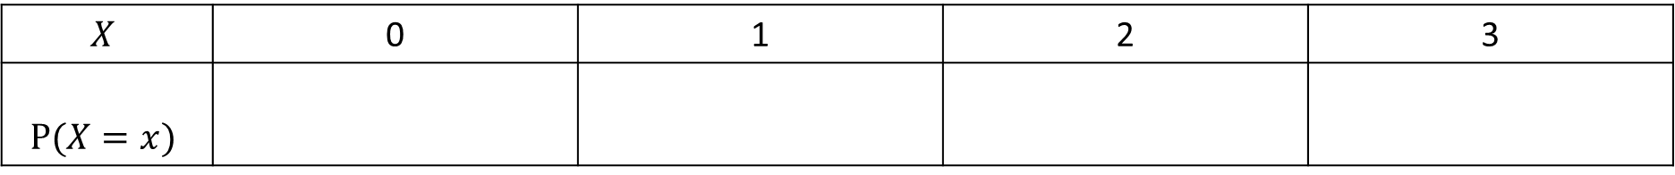


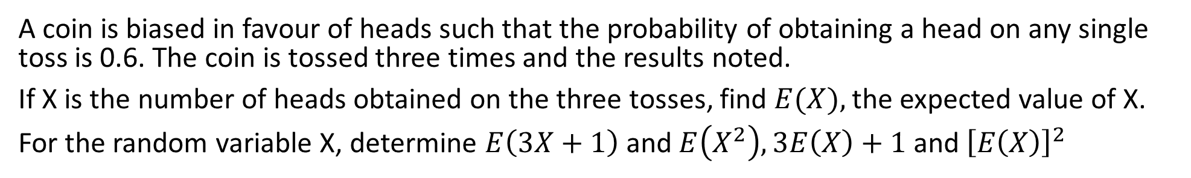
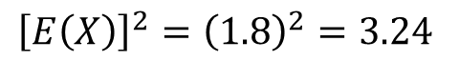
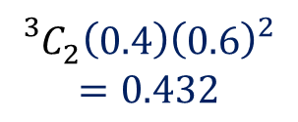

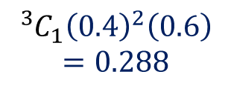

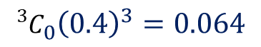


Guided Practice
A coin is biased in favour of heads such that the probability of obtaining a head on any single toss is 0.6. The coin is tossed three times and the results noted.
If X is the number of heads obtained on the three tosses, find $E(X),$the expected value of X.
For the random variable X, determine $E\left(3X+1\right)$ and $E\left(X^{2}\right), 3E\left(X\right)+1$ and ${\left[E\left(X\right)\right]}^{2}$
$$X$$ | 0 | 1 | 2 | 3
$$P(X=x)$$
$${{{}_{ }^{3}C}_{1}\left(0.4\right)}^{2}\left(0.6\right)$$
$$=0.288$$
$${{}_{ }^{3}C}_{2}\left(0.4\right){\left(0.6\right)}^{2}$$
$$=0.432$$
$${{{}_{ }^{3}C}_{3}\left(0.6\right)}^{3}=0.216$$
$${{{}_{ }^{3}C}_{0}\left(0.4\right)}^{3}=0.064$$
$$=1.8$$
$$E\left(X\right)=0\left(0.064\right)+1\left(0.288\right)+2\left(0.432\right)+3(0.216)$$
$$E\left(3X+1\right)=(3\left(0\right)+1)\left(0.064\right)+(3\left(1\right)+1)\left(0.288\right)+(3\left(2\right)+1)\left(0.432\right)+(3\left(3\right)+1)(0.216)$$
$$=6.4$$
$$3E\left(X\right)+1=3\left(1.8\right)+1$$
$$=6.4$$
$$E\left(X^{2}\right)=0^{2}\left(0.064\right)+1^{2}\left(0.288\right)+2^{2}\left(0.432\right)+3^{2}(0.216)$$
$$=3.96$$
$${\left[E\left(X\right)\right]}^{2}={\left(1.8\right)}^{2}=3.24$$
What do you notice?
$$E\left(3X+1\right)=3E\left(X\right)+1$$
$${E\left(X^{2}\right)≠\left[E\left(X\right)\right]}^{2}$$
$$∴ E\left(aX+b\right)=aE\left(X\right)+b$$

Slide 17
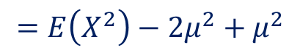
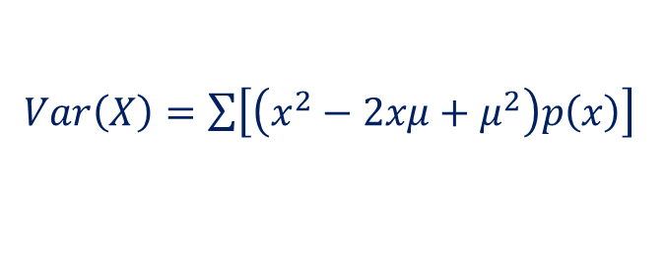
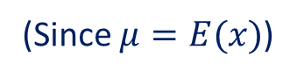
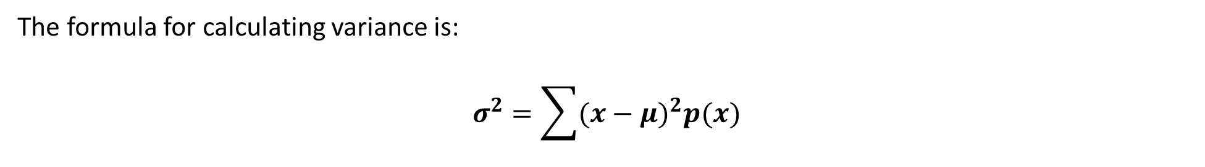
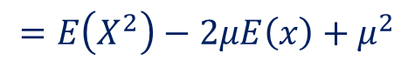
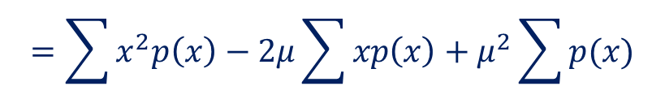
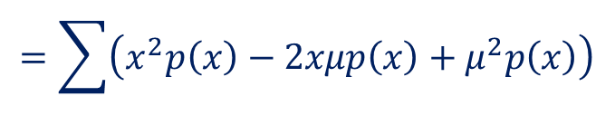
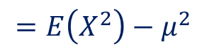
Calculating Standard Deviation (Alternatively)
The formula for calculating variance is:
$$σ^{2}=\sum{(x−μ)^{2}p(x)}$$
$Var\left(X\right)=\sum{\left[\left(x^{2}−2xμ+μ^{2}\right)p\left(x\right)\right]}$
$$=\sum{\left(x^{2}p\left(x\right)−2xμp\left(x\right)+μ^{2}p\left(x\right)\right)}$$
$$=\sum{x^{2}p\left(x\right)}−2μ\sum{xp\left(x\right)}+μ^{2}\sum{p(x)}$$
$$=E\left(X^{2}\right)−2μE\left(x\right)+μ^{2}$$
(Since $μ=E(x)$)
$$=E\left(X^{2}\right)−2μ^{2}+μ^{2}$$
$$=E\left(X^{2}\right)−μ^{2}$$

Slide 18
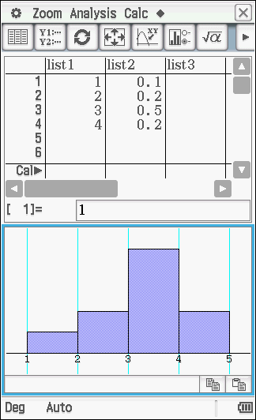
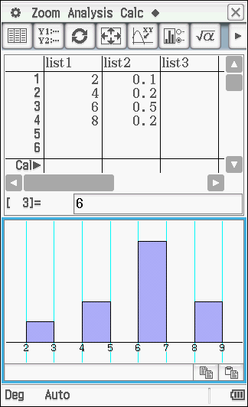
Change of Origin and Scale
What happens when you multiply a dataset by a scale factor?
On the left is the original dataset. On the
right is the transformed dataset when each
score is multiplied by a scale factor of 2.
If the dataset is multiplied by 2, the
expected value will also be multiplied by 2.
Notice the spread of data has increased too.
The standard deviation would be multiplied
by 2, while the variance would be multiplied
by 2².

Slide 19

Change of Origin and Scale
What happens when you add a constant to each data point?
On the left is the original dataset. On the
right is the transformed dataset when 2 has
been added to each score.
If the dataset has increased by 2, the
expected value will also increased by 2.
Notice the spread of data has not changed.
The standard deviation would not change
from the original, and neither would the
variance.

Slide 20
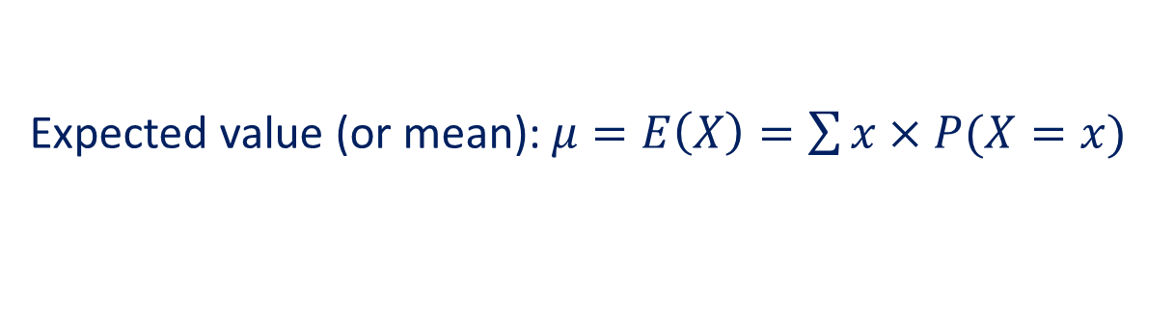
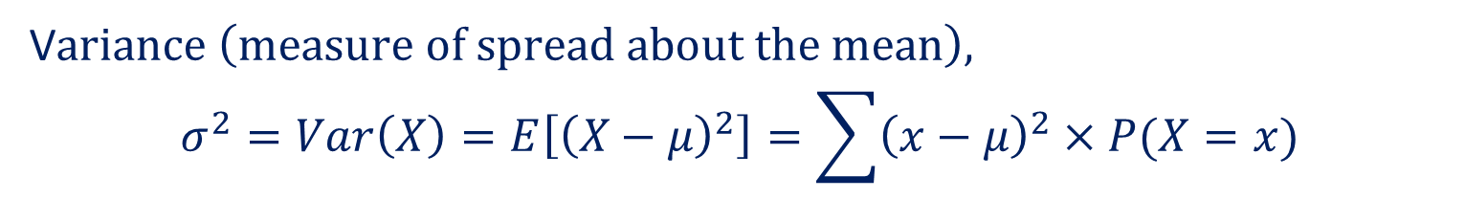
Summary so far…
Expected value (or mean):$μ=E\left(X\right)=\sum{x×P(X=x)}$
$E\left(aX+b\right)=aE\left(X\right)+b, a,b$ are constant
V$ariance \left(measure of spread about the mean\right),$
$$σ^{2}=Var\left(X\right)=E\left[{\left(X−μ\right)}^{2}\right]=\sum{{\left(x−μ\right)}^{2}×P(X=x)}$$
$Var\left(aX+b\right)=a^{2}Var(X), a,b$ are constant
Standard Deviation$, σ=sd\left(X\right)=\sqrt{Var\left(X\right)}$
$sd\left(aX+b\right)=a sd(X), a,b$ are constant

Slide 21
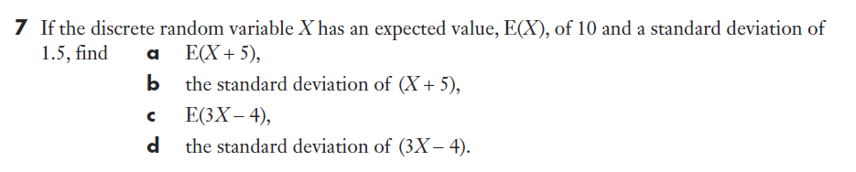
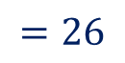
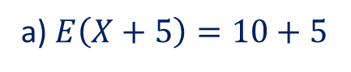
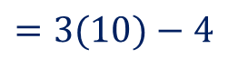
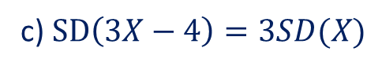
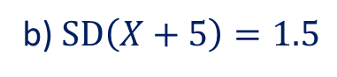
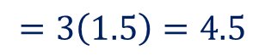
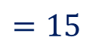
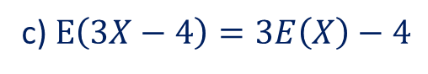
Guided Practice
a) $E\left(X+5\right)=10+5$
$=15$
b) $SD\left(X+5\right)=1.5$
c) $E\left(3X−4\right)=3E\left(X\right)−4$
$=3(10)−4$
$$=26$$
c) $SD\left(3X−4\right)=3SD(X)$
$$=3\left(1.5\right)=4.5$$

Slide 22
Guided Practice
The discrete random variable X can take the values 1, 2, 3 and 4 with the probability distribution as given in the table below:
Find E(X), the expected value of X, and Var(X) the variance of X
If Y = 3X, find E(Y) the expected value of Y, and Var(Y) the variance of Y
If Z = 3X + 4, find E(Z) the expected value of Z, and Var(Z) the variance of Z
X | 1 | 2 | 3 | 4
P(X = x) | 0.1 | 0.2 | 0.4 | 0.3

Slide 23
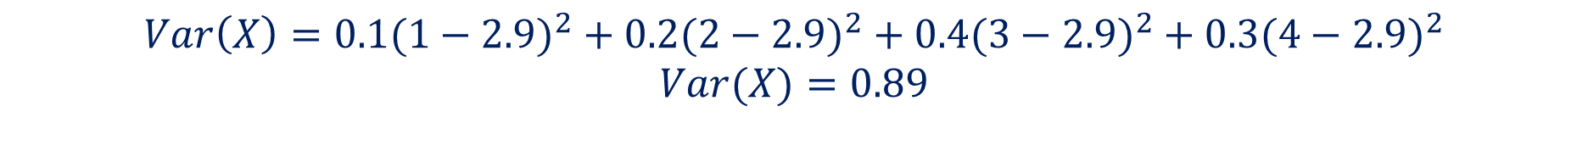
Guided Practice
The discrete random variable X can take the values 1, 2, 3 and 4 with the probability distribution as given in the table below:
Find E(X), the expected value of X, and Var(X) the variance of X
X | 1 | 2 | 3 | 4
P(X = x) | 0.1 | 0.2 | 0.4 | 0.3
$$E\left(X\right)=\left(1×0.1\right)+\left(2×0.2\right)+\left(3×0.4\right)+\left(4×0.3\right)=0.1+0.4+1.2+1.2=2.9$$
$$Var\left(X\right)=0.1(1−2.9)^{2}+0.2(2−2.9)^{2}+0.4(3−2.9)^{2}+0.3(4−2.9)^{2}$$
$$Var(X)=0.89$$

Slide 24
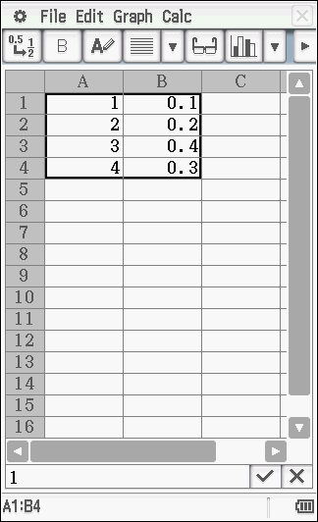
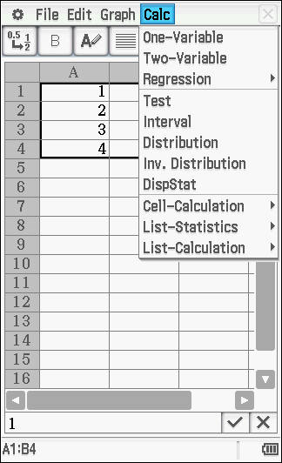
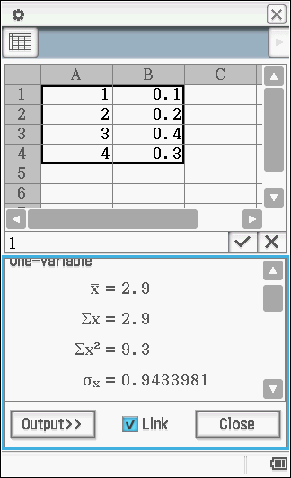
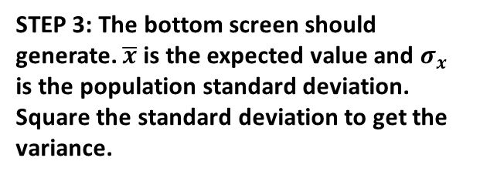
Guided Practice
STEP 1: Go to Spreadsheet and insert the table of values as shown. Select the whole table.
STEP 2: Go to Calc, then one-variable
STEP 3: The bottom screen should generate. $\overline{x}$ is the expected value and $σ_{x}$ is the population standard deviation. Square the standard deviation to get the variance.

Slide 25

Guided Practice
The discrete random variable X can take the values 1, 2, 3 and 4 with the probability distribution as given in the table below:
If Y = 3X, find E(Y) the expected value of Y, and Var(Y) the variance of Y
X | 1 | 2 | 3 | 4
P(X = x) | 0.1 | 0.2 | 0.4 | 0.3
$$E\left(Y\right)=3E\left(X\right)$$
$$E\left(Y\right)=3×2.9=8.7$$
$$Var\left(Y\right)=3^{2}×Var(X)$$
$$Var\left(Y\right)=8.01$$
Remember that variance is in ‘square’ units
so the scale factor is squared for the variance.

Slide 26

Guided Practice
The discrete random variable X can take the values 1, 2, 3 and 4 with the probability distribution as given in the table below:
If Z = 3X + 4, find E(Z) the expected value of Z, and Var(Z) the variance of Z
X | 0 | 1 | 2 | 3
P(X = x) | 0.1 | 0.2 | 0.4 | 0.3
$$E\left(Z\right)=3E\left(X\right)+4$$
$$E\left(Z\right)=3×2.9+4=12.7$$
$$Var\left(Z\right)=3^{2}×Var(X)$$
$$Var\left(Z\right)=8.01$$

Slide 27
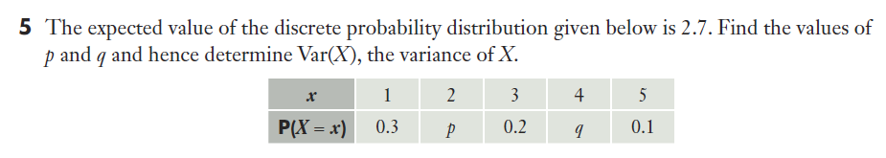
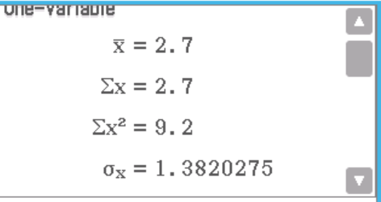


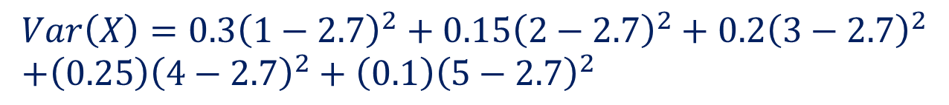




Guided Practice
$$0.3+p+0.2+q+0.1=1$$
$$p+q=0.4 −−(1)$$
$$E\left(X\right)=0.3+2p+3\left(0.2\right)+4q+5\left(0.1\right)=2.7$$
$$2p+4q=1.3 −−(2)$$
$$\left(2\right)−2\left(1\right), 2q=0.5$$
$$q=0.25$$
$$p=0.15$$
$$Var\left(X\right)=0.3{\left(1−2.7\right)}^{2}+0.15{\left(2−2.7\right)}^{2}+0.2{\left(3−2.7\right)}^{2} \\ +\left(0.25\right){\left(4−2.7\right)}^{2}+\left(0.1\right){\left(5−2.7\right)}^{2}$$
$$={1.3820275}^{2}=1.91$$

Slide 28
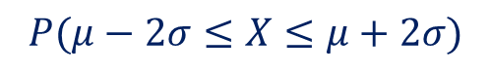


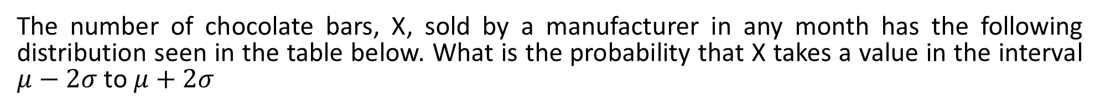


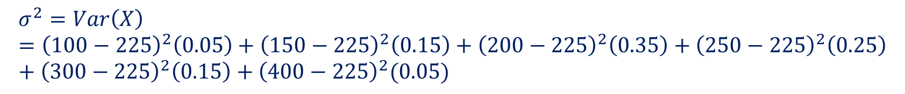


Guided Practice
The number of chocolate bars, X, sold by a manufacturer in any month has the following distribution seen in the table below. What is the probability that X takes a value in the interval $μ−2σ$ to $μ+2σ$
X | 100 | 150 | 200 | 250 | 300 | 400
P(X = x) | 0.05 | 0.15 | 0.35 | 0.25 | 0.15 | 0.05
$$μ=E\left(X\right)=100\left(0.05\right)+150\left(0.15\right)+200\left(0.35\right)+250\left(0.25\right)+300\left(0.15\right)+400(0.05)$$
$$=225$$
$$σ^{2}=Var\left(X\right)={\left(100−225\right)}^{2}\left(0.05\right)+{\left(150−225\right)}^{2}\left(0.15\right)+{\left(200−225\right)}^{2}\left(0.35\right)+{\left(250−225\right)}^{2}\left(0.25\right)+{\left(300−225\right)}^{2}\left(0.15\right)+{\left(400−225\right)}^{2}(0.05)$$
$$=4375$$
$$σ=\sqrt{4375}=66.14$$
$$P(μ−2σ≤X≤μ+2σ)$$
$$=P\left(225−2\left(66.14\right)≤X≤225+2\left(66.14\right)\right)$$
$$=P\left(92.72≤X≤357.28\right)$$
$$=P\left(100≤X≤300\right)$$
$$=1−0.05=0.95$$
Property - 95% of the distribution lies within two standard deviation either side of the mean
$$P\left(μ−2σ≤X≤μ+2σ\right)≈0.95$$

Slide 29





Guided Practice
A manufacturer knows that the mean number of faulty light bulbs in a batch of 10 000 is 12, with a standard deviation of 3. He wishes to claim to his clients that 95% of batches will contain between $c_{1}$ and $c_{2}$ faulty light bulbs. What are two possible values of $c_{1}$ and $c_{2}$?
$$μ=12$$
$$σ=3$$
Since $P\left(c_{1}≤X≤c_{2}\right)≈0.95$
$$P\left(μ−2σ≤X≤μ+2σ\right)≈0.95$$
$$c_{1}=μ−2σ$$
$$=12−2\left(3\right)$$
$$=6$$
$$c_{2}=μ+2σ$$
$$=12+2\left(3\right)$$
$$=18$$

Slide 30
Independent Practice
Complete Cambridge Ex 8D

